Slide 1






Hypothesis testing, Anova
ANKIT MIRAJKAR

Slide 2
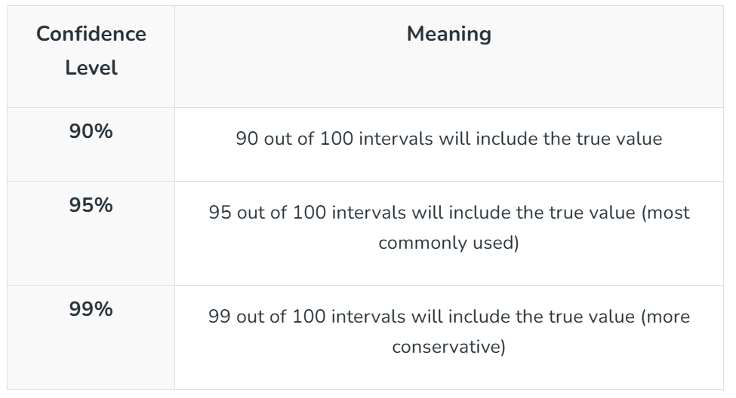
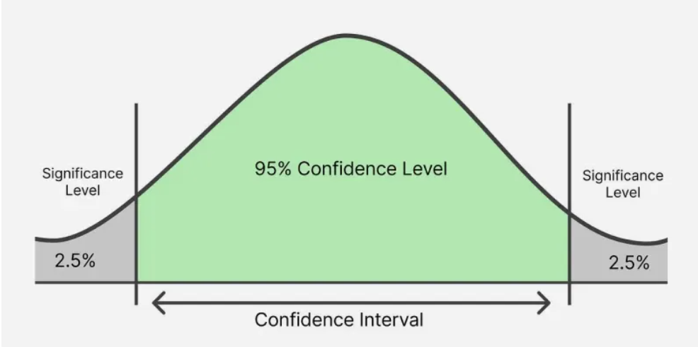
Confidence Intervals
A Confidence Interval (CI) is a range of values that contains the true value of something we are trying to measure like the average height of students or average income of a population.
Instead of saying: “The average height is 165 cm.”
We can say: “We are 95% confident the average height is between 160 cm and 170 cm.”
Interpreting Confidence Intervals
Let's say we take a sample of 50 students and calculate a 95% confidence interval for their average height which turns out to be 160–170 cm. This means If we repeatedly take similar samples 95% of those intervals would contain the true average height of all students in the population.
Confidence level tells us how sure we are that the true value is within a calculated range. If we have to repeat the sampling process many times we expect that a certain percentage of those intervals will include the true value.

Slide 3
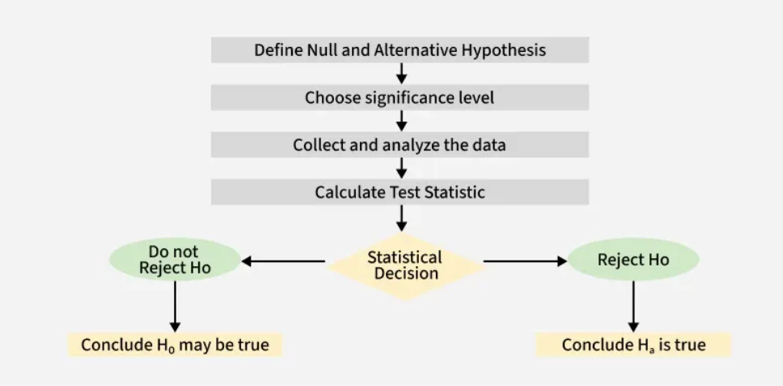
Hypothesis Testing
Hypothesis testing compares two opposite ideas about a group of people or things and uses data from a small part of that group (a sample) to decide which idea is more likely true. We collect and study the sample data to check if the claim is correct.
For example,
If a company says its website gets 50 visitors each day on average, we use hypothesis testing to look at past visitor data and see if this claim is true or if the actual number is different.
Defining Hypotheses
Null Hypothesis (H₀): The starting assumption. For example, "The average visits are 50."
Alternative Hypothesis (H₁): The opposite, saying there is a difference. For example, "The average visits are not 50.“
P-value: Probability of observing the result if H₀ is true.
Significance level (α): Commonly 0.05.

Slide 4


introduction to hypothesis testing
Hypothesis Testing is a type of statistical analysis in which you put your assumptions about a population parameter to the test. It is used to estimate the relationship between 2 statistical variables.
Lead content = 2.5 PPM
SAMPLE SIZE = 10000 Packets

Slide 5



1 hour
Home
Office
To under the characteristics of a general population, we take a random sample and analyze the properties of the sample.
We test whether or not the identified conclusion represents the population accurately and finally we interpret their results.
Whether or not to reject the hypothesis depends upon the percentage value that we get from the hypothesis.

Slide 6
Null & alternate hypothesis
The probability and hypothesis testing give rise to two important concepts, namely:
Null Hypothesis (H0): Result is no different from assumption.
Alternate Hypothesis (H1): Result disproves the assumption.
Suppose an experiment is conducted to check if girls are shorter than boys at the age of 5.
The null hypothesis will say that they are the same height AND the alternative hypothesis would be that girls are shorter than boys at the age of 5.
OUTCOME OF HYPOTHESIS
Rejection of NULL hypothesis: Guilty
Failure to reject NULL hypothesis: Not Guilty
As per our example, where the average time to commute from home to office is 1 hour. What will be our null hypothesis?
Employees take an average of 1 hour to commute from home to office
Employees take more than 1 hour to commute from home to office

Slide 7
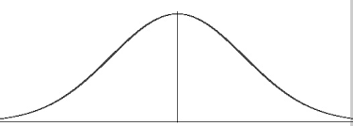
CRITICAL VALUE METHOD
All sets of values that lead to rejecting the null hypothesis lie in the critical region.
Furthermore, the value that separates the critical region from the non-critical region is known as the critical value.
E.g. Amit’s claim: Average score in archery = 100
H0: µ = 100
X̄ = 20
LCV: 70
HCV: 130
5 Games of archery
Average score = 20
Average score = 89
(Less likely to believe his claim)
(More likely to believe his claim)
Such methods are called as “Two tailed test”
LCV
µ
HCV

Slide 8
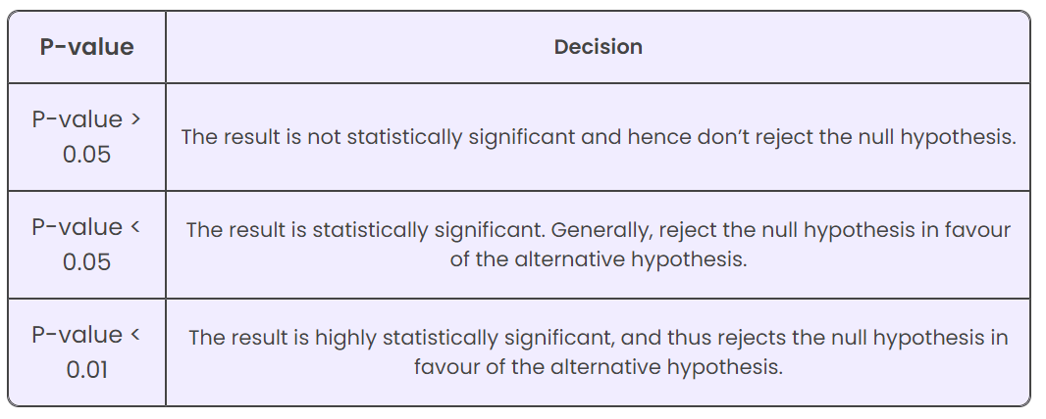
P-Value
The p value is a number, calculated from a statistical test, that describes how likely you are to have found a particular set of observations if the null hypothesis were true.
The P-value is known as the level of marginal significance within the hypothesis testing
P values are used in hypothesis testing to help decide whether to reject the null hypothesis. The smaller the p value, the more likely you are to reject the null hypothesis.
That is, As the p-value decreases the statistical significance of the observed difference increases. If the p-value is too low, you reject the null hypothesis.

Slide 9
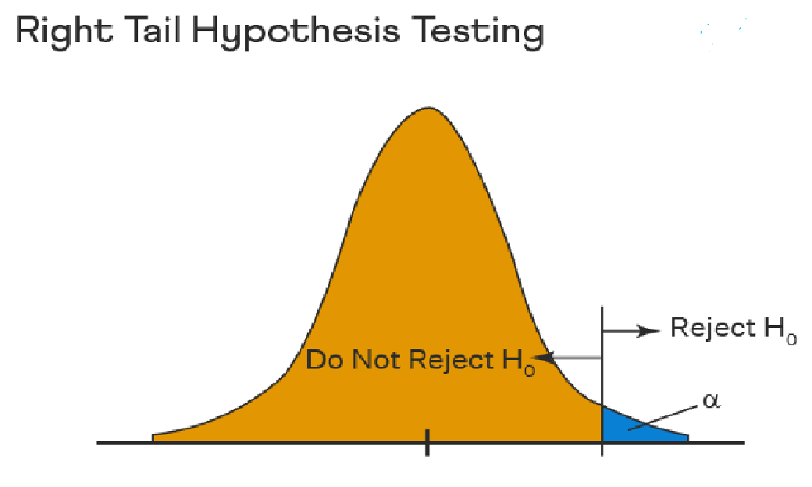
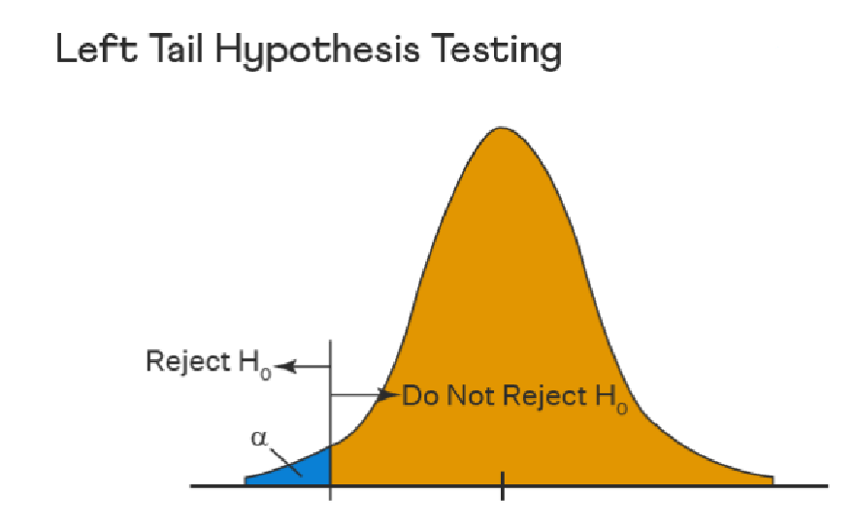
One Tailed Hypothesis Testing
One tailed hypothesis testing is done when the rejection region is only in one direction. It can also be known as directional hypothesis testing because the effects can be tested in one direction only.
This type of testing is further classified into the right tailed test and left tailed test.

Slide 10
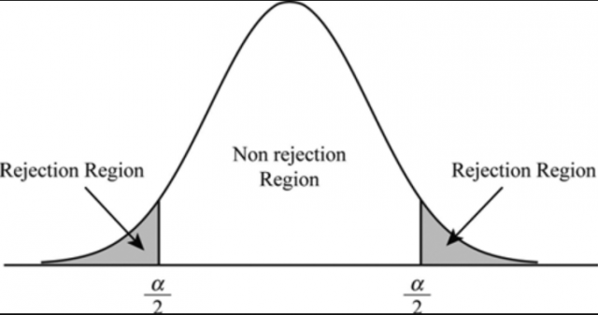
Level of Significance
In hypothesis testing, the level of significance is a measure of how confident you can be about rejecting the null hypothesis.
The alpha value is a criterion for determining whether a test statistic is statistically significant.
In a statistical test, Alpha represents an acceptable probability of a Type I error. Because alpha is a probability, it can be anywhere between 0 and 1.
In practice, the most commonly used alpha values are 0.01, 0.05, and 0.1, which represent a 1%, 5%, and 10% chance of a Type I error, respectively (i.e. rejecting the null hypothesis when it is in fact correct).
If you set your level of significance at 0.05 for example, it would mean that there’s only a five percent chance that the difference between groups (assuming two groups are tested) is due to random sampling error.

Slide 11
Types of Hypothesis Testing
Z Test
To determine whether a discovery or relationship is statistically significant, hypothesis testing uses a z-test. It usually checks to see if two means are the same (the null hypothesis). Only when the population standard deviation is known and the sample size is 30 data points or more, can a z-test be applied.
T Test
A statistical test called a t-test is employed to compare the means of two groups. To determine whether two groups differ or if a procedure or treatment affects the population of interest, it is frequently used in hypothesis testing.
Chi-Square
The Chi-square test analyzes the differences between categorical variables from a random sample. The test's fundamental premise is that the observed values in your data should be compared to the predicted values that would be present if the null hypothesis were true.

Slide 12
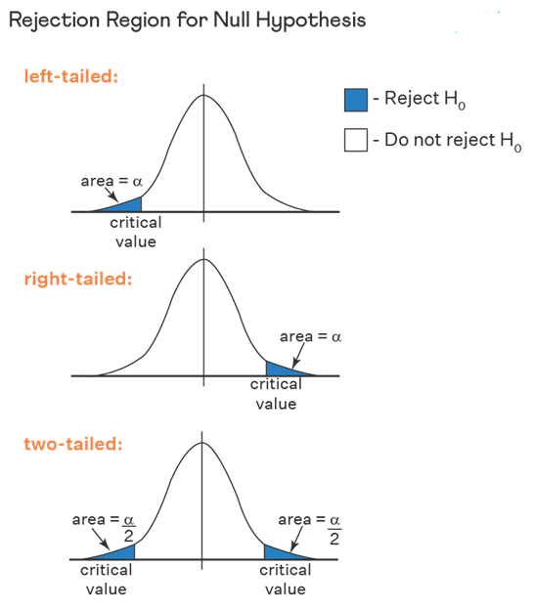
Z-test explained
Z test checks if the means of two large samples are different or not when the population variance is known.
A z test can further be classified into left-tailed, right-tailed, and two-tailed hypothesis tests depending upon the parameters of the data.
A z test is conducted on a population that follows a normal distribution with independent data points and has a sample size that is greater than or equal to 30.

Slide 13
T-test explained
A t-test is a statistical calculation that measures the difference in means between two sample groups
T-tests can help you measure the validity of results in fields like marketing, sales and accounting.
Conducting a t-test involves inputting the mean and standard deviation values into a defined formula.
Statistical research and data analysis apply t-tests to evaluate whether the differences that appear within a sample group occur by chance.

Slide 14
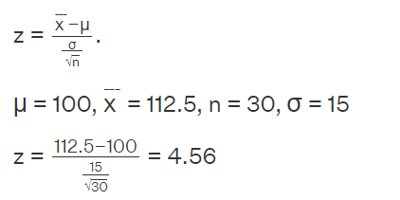
EXAMPLE
A researcher claims that the mean average weight of men is greater than 100kgs with a standard deviation of 15kgs. 30 men are chosen with an average weight of 112.5 Kgs. Using hypothesis testing, check if there is enough evidence to support the researcher's claim. The confidence interval is given as 95%.
Step 1: This is an example of a right-tailed test. Set up the null hypothesis as H0: μ= 100.
Step 2: The alternative hypothesis is given by H1: μ > 100.
Step 3: As this is a one-tailed test, α = 100% - 95% = 5%. This can be used to determine the critical value.
1 - α = 1 - 0.05 = 0.95
0.95 gives the required area under the curve. Now using a normal distribution table, the area 0.95 is at z = 1.96. A similar process can be followed for a t-test. The only additional requirement is to calculate the degrees of freedom given by n - 1.
Step 4: Calculate the z test statistic. This is because the sample size is 30. Furthermore, the sample and population means are known along with the standard deviation.
Step 5: Conclusion. As 4.56 > 1.96 thus, the null hypothesis can be rejected.

Slide 15
ANOVA
Analysis of variance (ANOVA) is a statistical technique used to check if the means of two or more groups are significantly different from each other.
ANOVA checks the impact of one or more factors by comparing the means of different samples.
Example:
Consider a scenario where we have three medical treatments for patients with similar diseases. Once we have the test results, one approach is to assume that the treatment which took the least time to cure the patients is the best among them. What if some of these patients had already been partially cured, or if any other medication was already working on them?

Slide 16
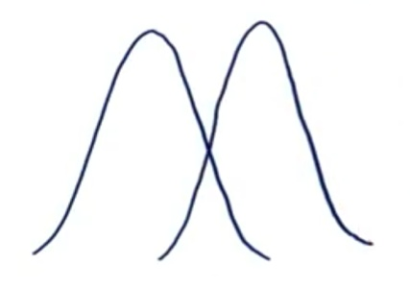
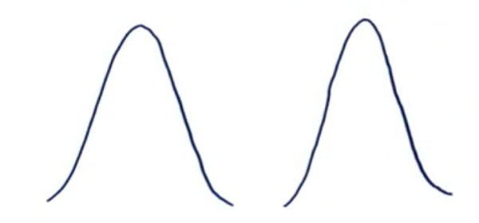
Terminologies for ANOVA
Grand Mean
The grand mean is the mean of sample means or the mean of all observations combined, irrespective of the sample.
Between Group Variability
Consider the distributions of the below two samples. As these samples overlap, their individual means won’t differ by a great margin. Hence the difference between their individual and grand means won’t be significant enough.
Now consider these two sample distributions. As the samples differ from each other by a big margin, their individual means would also differ. The difference between the individual means and grand mean would, therefore, also be significant.
Such variability between the distributions is called Between-group variability.

Slide 17
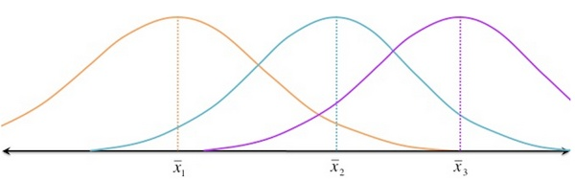
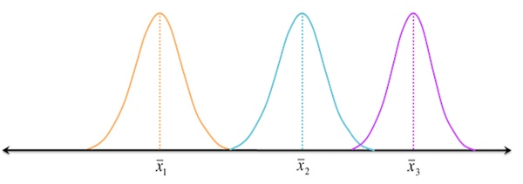
Terminologies for ANOVA
Within Group Variability
Consider the given distributions of three samples. As the spread (variability) of each sample increases, their distributions overlap, and they become part of a big population.
Now consider another distribution of the same three samples but with less variability. Although the means of samples are similar to those in the above image, they seem to belong to different populations.
Such variations within a sample are denoted by Within-group variation.
We can measure Within-group variability by looking at how much each value in each sample differs from its respective sample mean.

Slide 18
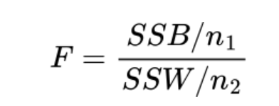
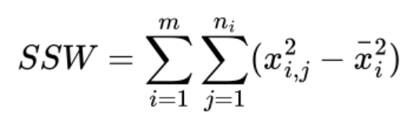
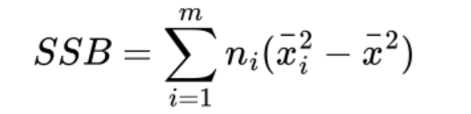
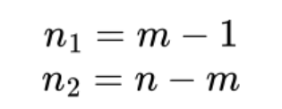
F-Statistic
The test statistic for the ANOVA test is the F-Statistic, which is calculated as follows:
Where;
n_1 and n_2 are the degrees of freedom for each Sum of Squares (between and within groups):
Where m is the number of groups and n is the total number of data points.

Slide 19
If the F statistic is smaller than the critical F value:
Accept the null hypothesis, H0, as a reasonable possibility.
Do not accept the research hypothesis, H1.
The sample averages are not significantly different from each other.
The observed differences among the sample averages could reasonably be due to random chance alone.
The result is not statistically significant. (All of the above statements are equivalent to one another.)
If the F statistic is larger than the critical F value:
Reject the null hypothesis, H0.
Accept the alternate hypothesis, H1
The sample averages are significantly different from each other.
The observed differences among the sample averages could not reasonably be due to random chance alone.
The result is statistically significant. (All of the above statements are equivalent to one another.)

Slide 20
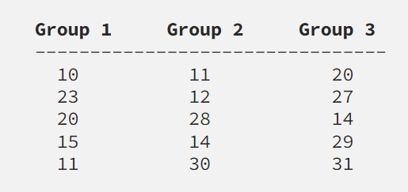


EXAMPLE
We are investigating whether the effect of three different types of pill on weight loss. Through giving three separate groups of people one of these three pills, we observe the following loss in weight (in kg) :
Hypotheses and Significance Level
H0: all three pills have the same effect on weight loss. So, the means between groups aren’t significantly different
H1: at least one of the pills is better or worse weight loss than the others. So, the means between groups are significantly different:
For this test we will use a significance level of 5%, which is the standard.

Slide 21
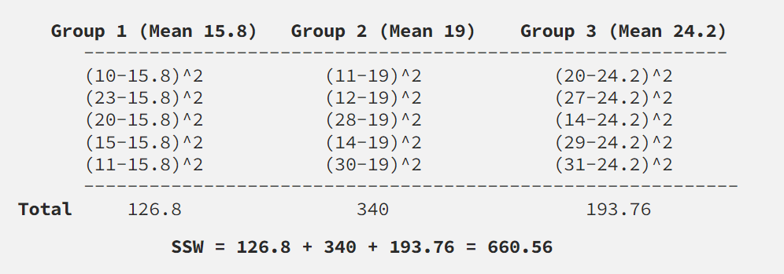
SSW
Now we calculate the Sum of Squares within each group
Where;
n_i is the number of data points in each group,
m is the number of groups,
x̄_i is the mean of each group and
x_i,j are the data points.

Slide 22
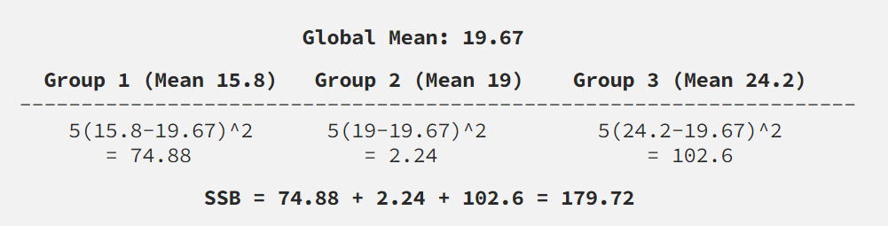
SSB
Now we calculate the Sum of Squares between groups
Where;
n is the number of data points in each group,
m is the number of groups,
x̄_i is the mean of each group and
x̄ is the grand mean.

Slide 23
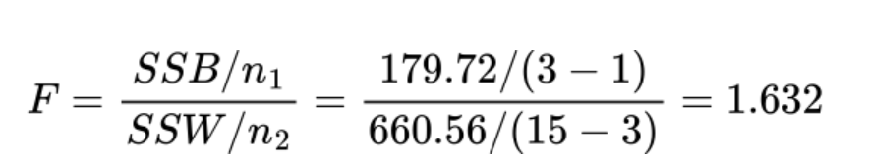
F-Statistic and Critical Value
We can compare this to our critical value, which we can find using the F-Distribution Table.
We know our degrees of freedom are 2 and 12 (from the above equation), thus the critical value is 3.89.
Therefore, 1.632 < 3.89, we fail to reject the null hypothesis and each weight loss pill has a similar effect!

